Slide 1
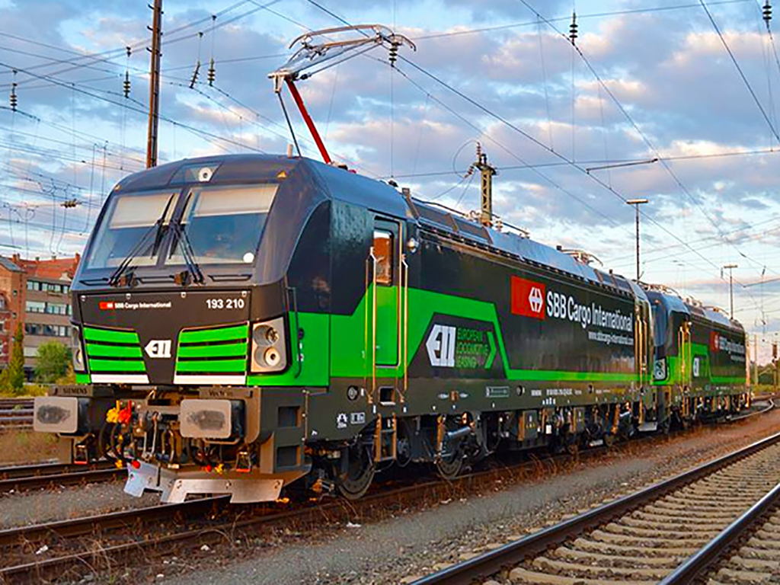
Electric traction system
Powerpoint presentation by:-
Poonam sharma
Lecturer electrical
G.P.Manesar

Slide 24
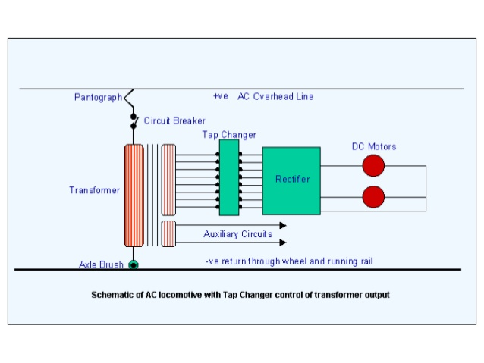

Slide 25
Main Parts of AC Electric Locomotive
The figure below shows the block diagram of an AC locomotive system that employs single phase supply to drive three phase motor.
The various components of this system include overhead contact wire, circuit breakers, pantograph, transformer, three phase traction motor, rectifier, inverter, smoothing reactor, etc.

Slide 26
Pantograph
The main function of pantograph is to maintain link between overhead conductor and power circuit of locomotive at different speeds of the vehicle under all wind conditions. It collects the current from overhead conductor and supplies to rest circuit.
Circuit Breaker
It protects the power circuit in the event of any fault by isolating it from the supply. It also isolates the circuit during maintenance.
Transformer
It receives the high voltage from overhead conductor via pantograph and circuit breaker and then step-down the voltage to desired level required by the rest circuit.

Slide 27
Rectifier
It converts a low voltage AC supply from the secondary of transformer to a DC supply.
DC Link
It connects the rectifier and inverter circuits. It consists of filter arrangement (capacitor and inductor arrangement) that filters the output from rectifier (by removing the harmonics form it) and then supplies it to the inverter.
Main Inverter
It converts the DC power to three phase AC power in order to drive three phase AC motors.
Axle Brush
It acts as a return path for the supply. Once the power is drawn to the locomotive from overhead system, the current complete its path through axle brush and one of running tacks.

Slide 28
Auxiliary Inverter
This inverter supplies the power to other parts in the locomotive unit including fans, motor blowers, compressors, etc.
Battery
It supplies the necessary starting current and also power up the essential circuits such as emergency lighting.
Compressor
It maintains the cooling/heating requirement in the locomotive unit.
Cooling Fans
These fans maintain the necessary cooling for the power circuits. Modern locomotive systems use electronically controlled air management systems to keep the desired temperature.

Slide 29
there are four types of track electrification systems are available based on the availability of supply. These are
DC traction system
Single phase AC traction system
Three phase AC traction system
Composite traction system

Slide 30
Single Phase AC Traction System
In this type of traction system, AC series motors are used to produce the propulsion of vehicle. This system uses AC voltages from 15-25KV at a frequency of 16.7 (i.e., 16 2/3) or 25 Hz. This low frequency leads to give better performance and more efficient operation by the series motor.
This single phase supply is fed to the locomotive unit via a single overhead line while track provides the return path.
The high voltages (15-25KV) obtained from overhead conductor are stepped down to a suitable motor operating range (typically 300-400V range) using step-down transformer carried by the locomotive unit itself.
The secondary tapping of this transformer offer variable voltage to AC series motor for speed regulation.
The low frequency operation of overhead line reduces the communication interferences. Also, the reactance of the line is low at lower frequency and hence the voltage drop in the line is reduced.
Because of this low line voltage drop, it is feasible to locate the substations at 50 to 80kms apart from each other. Therefore, this system is preferred for main line services where cost of overhead system is not a much important factor and for suburban services where rapid acceleration and retardation are not required.

Slide 31
Three Phase AC Traction System
In this, three phase induction motors are used for the movement of locomotive. This system normally works on 3000-3600V AC at a frequency either 16 2/3 or normal supply frequency.
This system employs two overhead lines for two phases, whereas the track forms third phase. These conductors are powered from substations which are rated at higher voltages and they receive power from three-phase transmission lines.
The high voltages from transmission lines are stepped down to 3.3 KV (3000-3600 V) by transformers while the frequency is reduced by frequency converters installed at substations.
The three phase induction motor used in this system has the following characteristics; simple and robust construction, provision of regenerative braking without additional equipment and high operating efficiency, better performance, etc.
However, these motors are suffer with some drawbacks such as high starting current, low starting torque, complicated overhead structure, especially at crossings and junctions and not suitable constant speed characteristics of induction motor traction work.
These systems are adopted where high output power is required and also where automatic regeneration braking is needed. However, these systems do not found much favour compared to other systems.

Slide 32
Composite Traction System
The above discussed methods have their own merits and demerits. Single phase AC system has less distribution cost whereas DC system has excellent driving capability by DC series motors and three phase system has automatic regenerative braking capacity.
So by combining the advantages of AC/DC and single/three phase systems, the overall performance of the traction system gives better result than individual system and hence the evolution of composite system.
Basically composite systems are of two types, namely
Single phase to three phase system
Single phase to DC system

Slide 33
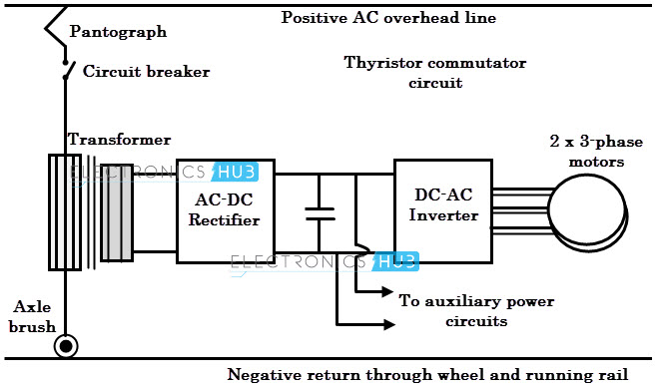
Single phase to three phase system
This traction system is also called Kando system. It consists of single phase16KV, 50 Hz supply which is fed from the substation and is being carried through a single overhead conductor.
The single phase supply is then converted into three phase supply of the same frequency using phase converter equipment in the locomotive itself. The three phase supply is then fed to induction motors to drive the locomotive.

Slide 34
It is also possible to develop high starting torque of induction motors by reducing the supply frequency at ½ to 9 Hz by means of inverter controlled through silicon controlled rectifiers.
The main advantage of this system is that the overhead two conductor arrangement of three phase AC system is reduced to a single overhead conductor and hence more economical.

Slide 35
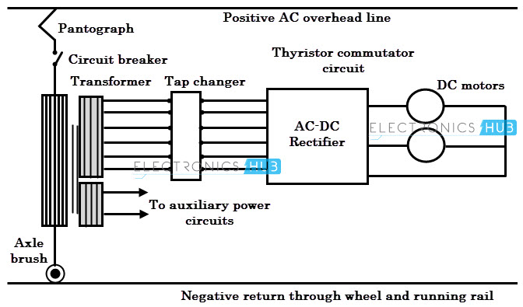
Single phase to DC system
This traction system is most popular and widely used system everywhere. It combines the single phase high voltage AC distribution at industrial frequency with DC series motor traction.
In this, the overhead line carries single phase, 25KV, 50 Hz supply which is then stepped down to a desired range using step-down transformer located in the locomotive unit itself.

Slide 36
This single phase supply is then converted into DC using rectifier (in the locomotive) and then applied to DC series motor.
The advantages of this system include higher starting efficiency, less number of substations, simple substation design and lower cost of fixed installations.

